Slide 1
INTRODUCTION TO CONVOLUTIONAL NEURAL NETWORK

Slide 2
What are convolutional neural network?
CNN are special kind of neural network for processing data that has a known grid like topology like images (2D).
CNN are widely being used in the field of computer vision.
Applications of CNN:
Image processing
Object detection
Image classification
Face detection
Video analysis

Slide 3
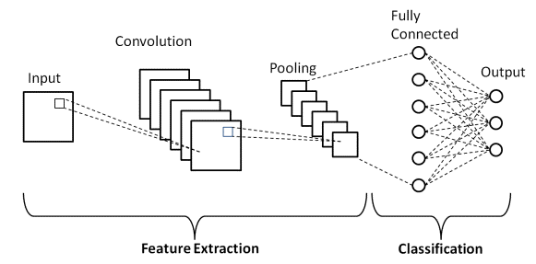
Structure of CNN
There are 3 layers in CNN:
Convolutional Layer
Pooling Layer
Fully connected layer

Slide 4
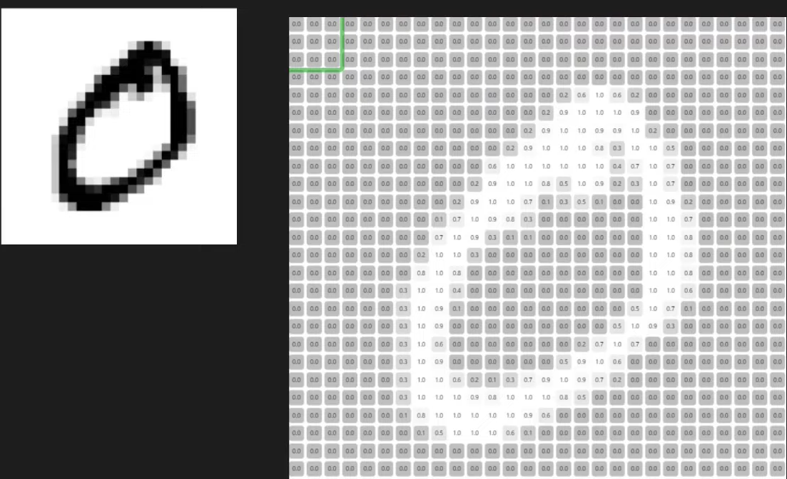
What are images?
Images are made of pixels.(0 to 255),
Where, 0 : black, 255 : white

Slide 5
Working of CNN
It tries to detect the primitive features from images. Primitive features are dominating or edges present in the images.
CNN detects these edges in convolutional networks. These network contains various filters for edge detection.
First convolutional layer will detect the primitive feature and we will pass these features to next layer for detections of more complex features by combining the previous features.
Extracted features are then flattened.
These flattened features and then passed as input features into fully connected layer for classification.

Slide 6
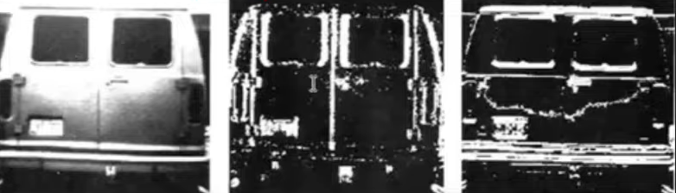
What is edge detection?
In an image edges are nothing but the change in intensity.
There are filters in each convolutional layer to detect different type of image.

Slide 7
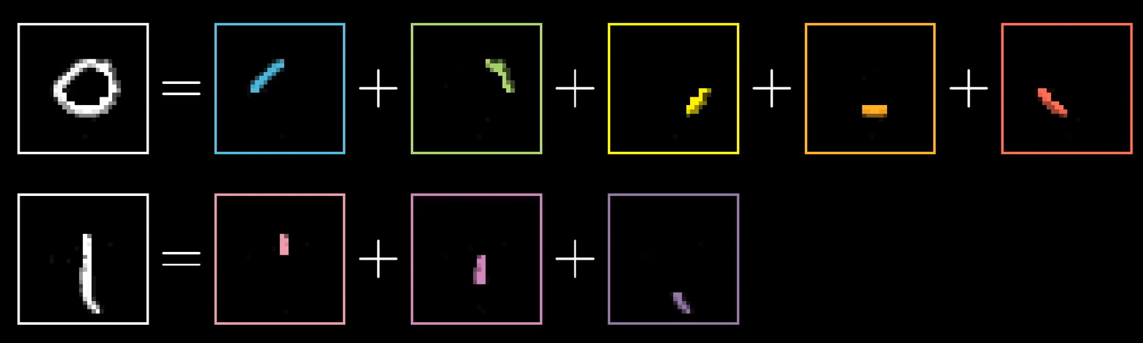
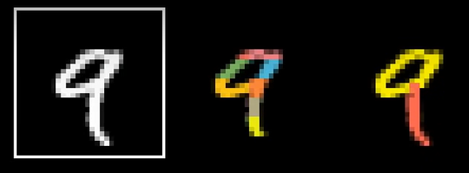

Slide 8
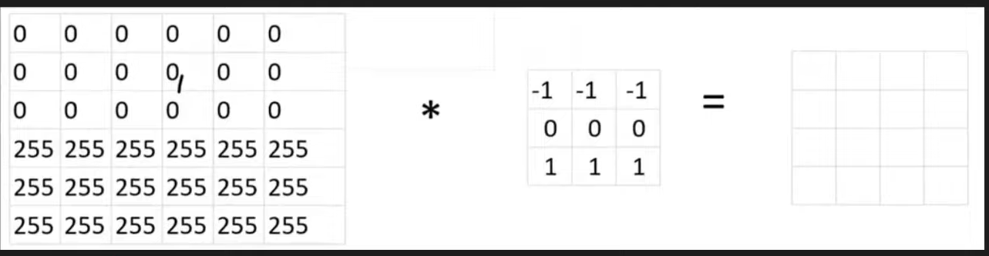
Edge detection intuition

Slide 9
Pooling Layer
Pooling layers are one of the building blocks of Convolutional Neural Networks. Where Convolutional layers extract features from images, Pooling layers consolidate the features learned by CNNs. Its purpose is to gradually shrink the representation’s spatial dimension to minimize the number of parameters and computations in the network.
Pooling layer is added after convolutional layer.
It down samples the output of convolutional layer.

Slide 10
Types of pooling
There are two types of pooling that are used:
Max pooling: This works by selecting the maximum value from every pool. Max Pooling retains the most prominent features of the feature map, and the returned image is sharper than the original image.
Average pooling: This pooling layer works by getting the average of the pool. Average pooling retains the average values of features of the feature map. It smoothens the image while keeping the essence of the feature in an image.

Slide 11
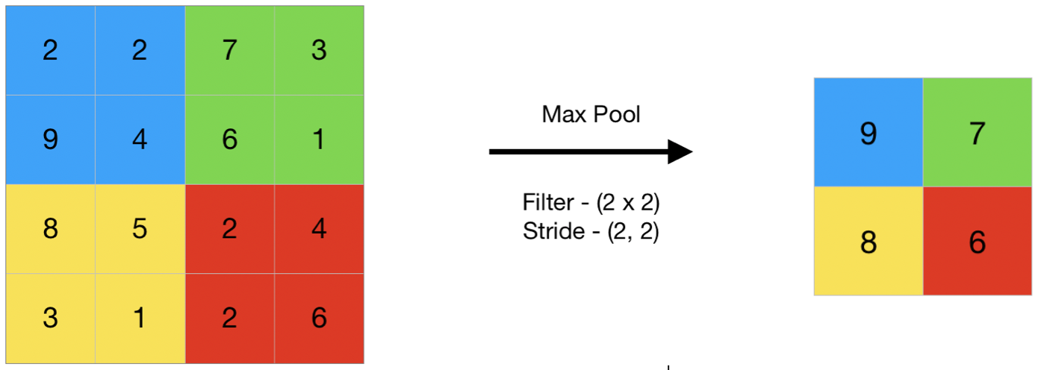
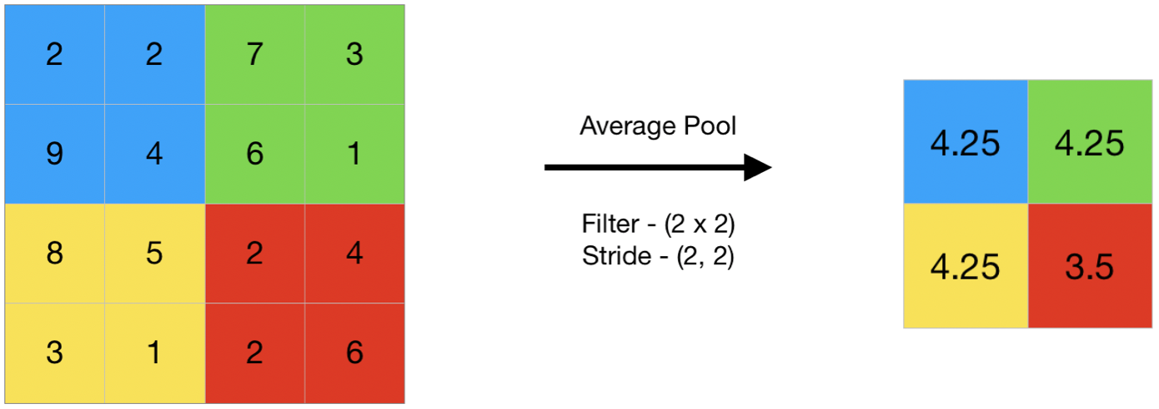

Slide 12
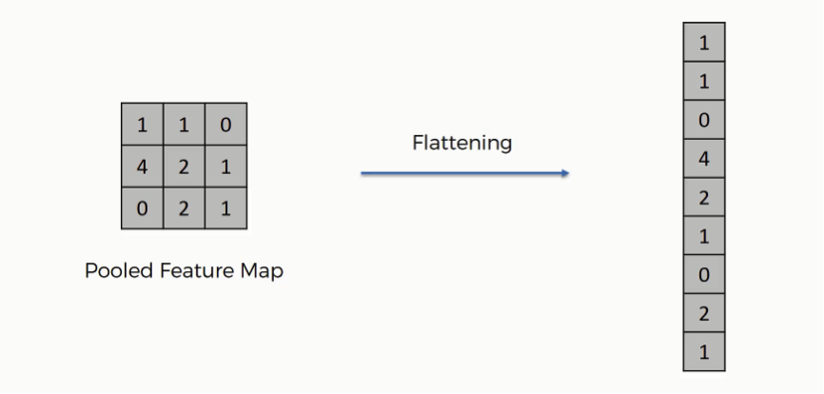
Flattening the image

Slide 13
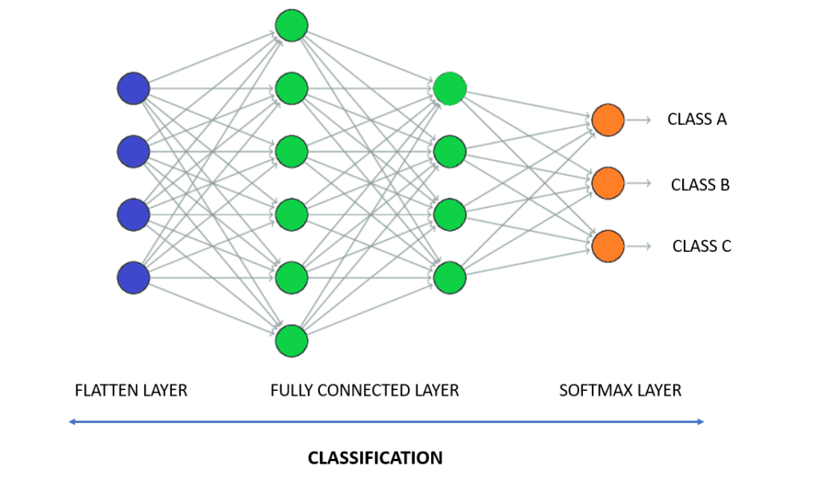
Fully Connected Layer

Slide 14
Thank You

